Slide 1



Pitch Workshop
Mike Fischer
7/20/2026

Slide 2


Today’s Objective
Learn Game Pitch Fundamentals
Practice Making & Presenting an Elevator Pitch

Slide 3

Most pitches don’t fail because they hate your idea
They fail because they don’t understand your idea
If they can't explain your game to their boss, the pitch is dead.

Slide 4
Video game pitches are unique
You have to mix the tech/business message with an art/magic message

Slide 5

You must convince heart and mind

Slide 6



Pitch Communication Pillars
Our game will be fun
Our game will
achieve our goals
We can be trusted
Product
Business Model
Team

Slide 7
Keep It Simple
+
Tell a Story

Slide 8
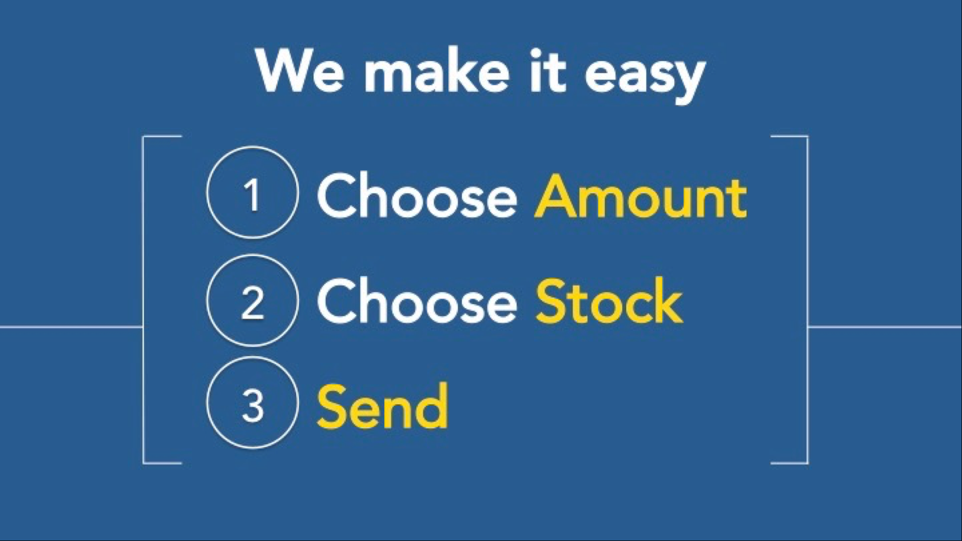
Simple
GOOD
BETTER
Push Button
Get Insurance

Slide 9




Tell a Story

Slide 10

Find your game’s “hook”
The Key Point. A simple statement that explains why your game will stand out
It's Hades meets Animal Crossing, where you manage a tavern for the souls you defeat.
It's Rocket League but with giant mechs in a destructible arena.
It fulfills a player’s dream of being a (rock star, pro skater, MMA champion)

Slide 11

Guy Kawasaki’s Guidelines
(for a standard pitch)
The 10/20/30 Rule of PowerPoint
Ten slides
Twenty minutes
30-point font (or larger)

Slide 12

Guy Kawasaki’s
Ten Slides
Title
Problem/Opportunity
Value Proposition (promise to the player)
Underlying magic/technology
Business model
Go to market plan
Competition
Team
Projections and KPIs
Status and timeline, budgets

Slide 13
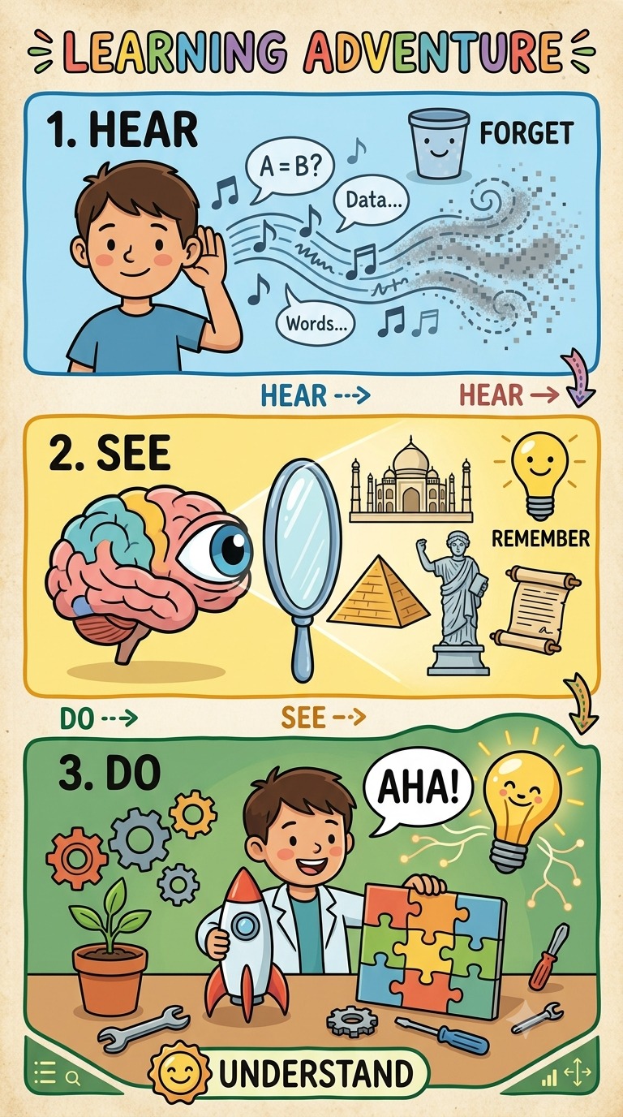

Show Don’t Tell
We could tell you about the game…
A fighting game using anthropomorphized animals as combatants. Each fighter has a unique set of attributes (both strengths and weaknesses) based on their animal type.

Slide 14
Show Don’t Tell
…or we could just show you.

Slide 15
Pitch Killers
❌ "Our game is for everyone." If it's for everyone, it's for no one. Define your core niche group first.
❌ "We have no competition." This tells investors either you haven't researched the market, or there is no money to be made in this genre.
❌ Overpromising: Pitching an MMO with a team of three people. Keep the scope grounded in reality.
❌ The Lore Trap: Spending 45 seconds of a 60-second pitch explaining the fantasy world's history instead of the game loop.
❌ Too Much Game Jargon: “A PvE Roguelike sandbox game with both TPS and FPS modes.”
❌ Too Much About Yourself: Don’t tell your whole life story,

Slide 16

Elevator Pitch
Quick! 60-second target
Key point
Player experience
Basic game idea
Business model

Slide 17
Communication Pyramid
Key
Point
How you feel
What you do

Slide 18
Pitch Exercise
Goal: Create and present a brief game pitch
Target: 1 minute
Group project or Solo
Brainstorm, Discuss, Create, Present
It’s not an idea contest
Happy to review your personal projects, too

Slide 19















Slide 20


The Thrill of Surfing + The Skill of Shooting

Slide 21
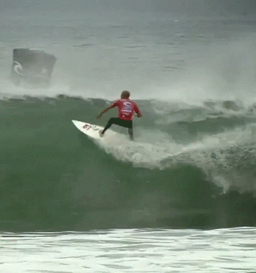

Surf Shooter
Live the fantasy of being a pro surfer
Feel the excitement of gun-crazy PvP play

Slide 22
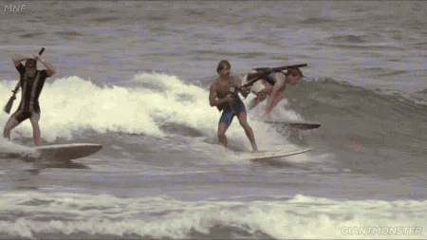
Game Basic Information
Battle royale shooting game at the beach
Catch a wave, surf and shoot
Last surfer alive is the winner

Slide 23
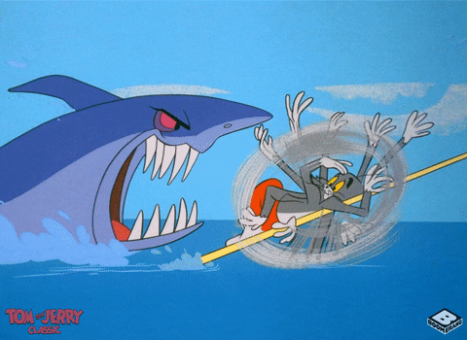
Game Basic Information
Earn bonus points for style and shooting targets
Look for power-up items in the water
Avoid the sharks!

Slide 24


Business Model
Free-to-play with microtransactions
Customize your surfboard, swimwear & weapon

Slide 25
Thank You
www.gamegoglobal.com

